Slide 1
Text Mining, Information and Fact Extraction
Part 2: Machine Learning Techniques
Marie-Francine Moens
Department of Computer Science
Katholieke Universiteit Leuven, Belgium sien.moens@cs.kuleuven.be

Slide 2
Problem
Symbolic techniques are useful in very restricted subject domains that exhibit standard patterns:
  e.g., mining of a weather report
In most settings language is characterized by:
  a variety of patterns that express the same or similar meanings
  ambiguous patterns that receive their meaning based on the context
Patterns change in time (e.g., blog and chat languages)

Slide 3
Problem
manual effort is huge to build all the needed (contextual) patterns for all kinds of information extraction tasks
IE in terrorism domain: experiment of Riloff (1996): automatic construction of dictionary of extraction patterns from an annotated training corpus achieved 98% of the performance of handcrafted patterns
  => machine learning of extraction patterns
[Riloff AI 1996]

Slide 4
Problem
Since 1996: interest in machine learning for information extraction:
  Usually supervised learning algorithms:
    e.g., learning of rules and trees, support vector machines, maximum entropy classification, hidden Markov models, conditional random fields
  Unsupervised learning algorithms:
    e.g., clustering (e.g., noun phrase coreferent resolution)
  Weakly supervised learning algorithms

Slide 5
Overview
Features
Supervised methods:
  Support vector machines and kernel methods
  Probabilistic models:
    Naive Bayes models
    Maximum entropy models
(exemplary results are added)

Slide 6
Symbols used
x = object (to be) classified
y = class label (to be) assigned to x

Slide 7
Generative versus discriminative classification
In classification: given inputs x and their labels y:
  Generative classifier learns a model of the joint probability p(x,y) and makes its predictions by using Bayes’ rule to calculate p(y|x) and then selects the most likely label y:
    e.g., Naive Bayes, hidden Markov model
    to make computations tractable: simplifying independence assumptions

Slide 8
Generative versus discriminative classification
  Discriminative classifier is trained to model the conditional probability p(y|x) directly and selects the most likely label y, or learns a direct map from inputs x to the class labels:
    e.g., maximum entropy model, support vector machine
    better suited when including rich, overlapping features

Slide 9
Maximum entropy principle
Text classifiers are often trained with incomplete information
Probabilistic classification can adhere to the principle of maximum entropy: When we make inferences based on incomplete information, we should draw them from that probability distribution that has the maximum entropy permitted by the information we have: e.g.,
  maximum entropy model, conditional random fields

Slide 10
Combining classifiers
Multiple classifiers are learned and combined:
  Bagging: e.g., sample of size n is taken randomly with replacement from the original set of n training documents
    Adaptive resampling: no random sampling, but objective = to increase the odds of sampling documents that previously induced classifiers have erroneously been classified
  Stacking: predictions from different classifiers are used as input for a meta-learner
  Boosting: generating a sequence of classifiers, after each classification greater weights are assigned to objects with an uncertain classification, and classifier is retrained

Slide 11
Feature selection and extraction
In classification tasks: object is described with set of attributes or features
Typical features in text classification tasks:
  word, phrase, syntactic class of a word, text position, the length of a sentence, the relationship between two sentences, an n-gram, a document (term classification), ….
  choice of the features is application- and domain-specific
Features can have a value, for text the value is often:
  numeric, e.g., discrete or real values
  nominal, e.g. certain strings
  ordinal, e.g., the values 0= small number, 1 = medium number, 2 = large number

Slide 12
Feature selection and extraction
The features together span a multi-variate space called the measurement space or feature space:
  an object x can be represented as:
    a vector of features:
    x = [x₁, x₂, …, x_{p}]^{T}
    where p = the number of features measured
    as a structure: e.g.,
      representation in first order predicate logic
      graph representation (e.g., tree) where relations between features are figured as edges between nodes and nodes can contain attributes of features

Slide 13
Feature selection
= eliminating low quality features:
    redundant features
    noisy features
decreases computational complexity
decreases the danger of overfitting in supervised learning (especially when large number of features and few training examples)
increases the chances of detecting valuable patterns in unsupervised learning and weakly supervised learning
Overfitting:
  the classifier perfectly fits the training data, but fails to generalize sufficiently from the training data to correctly classify the new case

Slide 14
Feature selection
In supervised learning:
  feature selection often incorporated in training algorithms:
    incrementally add features, discard features, or both, evaluating the subset of features that would be produced by each change (e.g., algorithms that induce decision trees or rules from the sample data)
  feature selection can be done after classification of new objects:
    by measuring the error rate of the classification
    those features are removed from or added to the feature set when this results in a lower error rate on the test set

Slide 15
Feature extraction
= creates new features by applying a set of operators upon the current features:
  a single feature can be replaced by a new feature (e.g., replacing words by their stem)
  a set of features is replaced by one feature or another set of features
    use of logical operators (e.g., disjunction), arithmetical operators (e.g., mean, dimensionality reduction)
  choice of operators: application- and domain-specific
In supervised learning can be part of training or done after classification of new objects

Slide 16
Support vector machine (SVM)
Discriminant analysis:
  determining a function that in a best way discriminates between two classes
  text categorization: two classes: positive and negative examples of a class
  e.g., linear discriminant analysis finds a linear combination of the features (variables) : hyperplane (line in two dimensions, plane in three dimensions, etc.) in the p-dimensional feature space that best separates the classes
  usually, there exist different hyperplanes that separate the examples of the training set in positive and negative ones

Slide 17
Support vector machine
Support vector machine:
  when two classes are linearly separable:
    find a hyperplane in the p-dimensional feature space that best separates with maximum margins the positive and negative examples
    maximum margins: with maximum Euclidean distance (= margin d) to the closest training examples (support vectors)
    e.g., decision surface in two dimensions
  idea can be generalized to examples that are not necessarily linearly separable and to examples that cannot be represented by linear decision surfaces

Slide 18
Support vector machine
Linear support vector machine:
  case: trained on data that are separable (simple case)
  input is a set of n training examples:
  where x_{i} ∈ and y_{i} ∈ {-1,+1} indicating that x_{i} is a negative or positive example respectively

Slide 19
Support vector machine
Suppose we have some hyperplane which separates the positive from the negative examples, the points which lie on the hyperplane satisfy:
where w = normal to the hyperplane
= perpendicular distance from the hyperplane to the origin
= Euclidean norm of w

Slide 20
let d₊ (d₋) be the shortest distance from the separating hyperplane to the closest positive (negative) example
define the margin of the separating hyperplane to be d₊ and d₋
search the hyperplane with largest margin
Given separable training data that satisfy the following constraints:
for y_{i} =+1 (1)
for y_{i} = -1 (2)
which can be combined in 1 set of inequalities:
for i = 1,…, n (3)

Slide 21
The hyperplane that defines one margin is defined by:
with normal w and perpendicular distance from the origin
The hyperplane that defines the other margin is defined by:
with normal w and perpendicular distance from the origin
Hence d₊ = d₋ = and the margin =

Slide 22
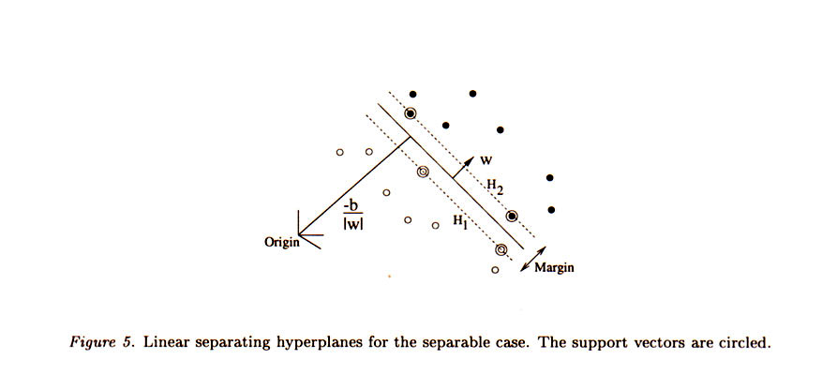
[Burges 1995]

Slide 23
Hence we assume the following objective function to maximize the margin:
A dual representation is obtained by introducing Lagrange multipliers λ_{i}, which turns out to be easier to solve:
        (4)

Slide 24
Yielding the following decision function:
(5)
The decision function only depends on support vectors, i.e., for which λ_{i} > 0. Training examples that are not support vectors have no influence on the decision function

Slide 25
Support vector machine
Trained on data not necessarily linearly separable (soft margin SVM):
  the amount of training error is measured using slack variables ξ_{i} the sum of which must not exceed some upper bound
  The hyperplanes that define the margins are now defined as:
Hence we assume the following objective function to maximize the margin:

Slide 26
where = penalty for misclassification
C = weighting factor
The decision function is computed as in the case of data objects that are linearly separable (cf. 5)

Slide 27
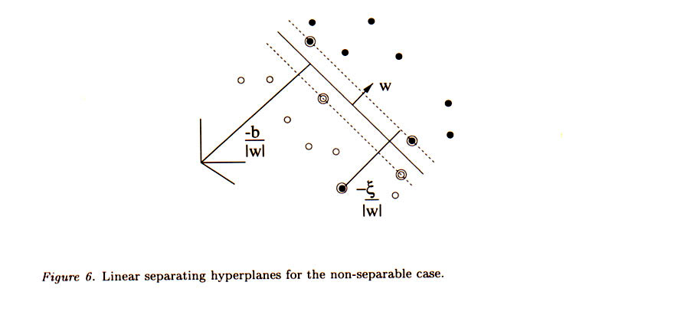
[Burges 1995]

Slide 28
Support vector machine
When classifying natural language data, it is not always possible to linearly separate the data: in this case we can map them into a feature space where they are linearly separable
Working in a high dimensional feature space gives computational problems, as one has to work with very large vectors
In the dual representation the data appear only inside inner products (both in the training algorithm shown by (4) and in the decision function of (5)): in both cases a kernel function can be used in the computations

Slide 30
Kernel function
A kernel function K is a mapping K: S x S → [0, ∞] from the instance space of training examples S to a similarity score:
In other words a kernel function is an inner product in some feature space
The kernel function must be:
  symmetric [K(x_{i},x_{j}) = K(x_{j},x_{i})]
  positive semi-definite: if x₁,…,x_{n} ∈ S, then the n x n matrix G (Gram matrix or kernel matrix) defined by G_{ij} = K (x_{i},x_{j}) is positive semi-definite*
  * has non-negative eigenvalues

Slide 31
Support vector machine
The decision function f(x) we can just replace the dot products with kernels K(x_{i},x_{j}):

Slide 32
Support vector machine
Advantages:
  SVM can cope with many (noisy) features: no need for a priori feature selection, though you might select features for reasons of efficiency
  many text categorization problems are linearly separable

Slide 33
Kernel functions
Typical kernel functions: linear (mostly used in text categorization), polynomial, radial basis function (RBF)
In natural language: data are often structured by the modeling of relations=> kernels that (efficiently) compare structured data: e.g.,
  Rational kernels = similarity measures over sets of sequences
    n-gram kernels
    convolution kernels
  Kernels on trees

Slide 34
n-gram kernels
n-gram is a block of adjacent characters from an alphabet Σ
n-gram kernel: to compare sequences by means of subsequences they contain:
#(s∈x_{i}) #(s∈x_{j})
where #(s∈x) denotes the number of occurrences of s in x
the kernel function can be computed in O(|x_{i}| + |x_{j}|) time and memory by means of a special suited data structure allowing one to find a compact representation of all subsequences in x in only O(|x|) time and space
[Vishwanathan & Smola 2004]

Slide 35
Convolution kernels
  Object x ∈ X consists of substructures x_{p} ∈ X_{p} where 1≤p≤r and r denotes the number of overall substructures
  Given the set of all possible substructures P(X), one can define a relation R (e.g., part of) between a subset of P and the composite object x
  Given a finite number of subsets, R is called finite
  Given a finite relation R,R⁻¹ defines the set of all possible decompositions of x into its substructures: R⁻¹(x)= {z ∈ P(X): R (z, x)}

Slide 36
Convolution kernels
The R-convolution kernel:
  is a valid kernel with K_{i} being a positive semi-definite kernel on X_{i}
The idea of decomposing a structured object into parts can be applied recursively so that one only requires to construct kernels over the “atomic” parts of X_{i}

Slide 37
Tree kernels
Based on convolution kernels
A tree is mapped into its sets of subtrees, the kernel between two trees K(x_{i}, x_{j}) is then computed by taking the weighted sum of all terms between both trees
Efficient algorithms to compute the subtrees:
  O(|x_{i}|.|x_{j}|), where |x| is the number of nodes of the tree
  O(|x_{i}|+|x_{j}|), when restricting the sum to all proper rooted subtrees
[Collins & Duffy 2004]
[Vishwanathan & Smola 2004]

Slide 38
Tree kernels
Comparison of augmented dependency trees for relation extraction from sentences:
  recursive function to combine parse tree similarity with similarity s(x_{i}, x_{j}) based on feature correspondence of the nodes of the trees
  where m(x_{i}, x_{j}) ∈ {0, 1} determines whether two nodes are matchable or not
  c = children subtrees

Slide 39
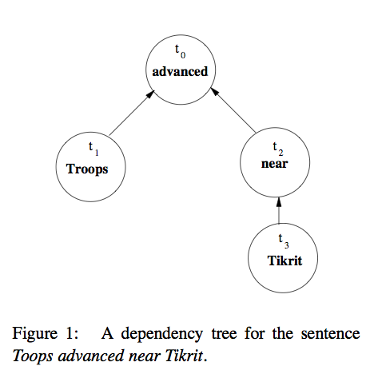
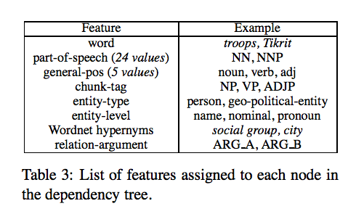
[Culotta & Sorensen 2004]

Slide 40
Naive Bayes (NB) model
Bayesian classifier:
  the posterior probability that a new, previously unseen object belongs to a certain class given the features of the object is computed:
    based on the probabilities that these individual features are related to the class
Naive Bayes classifier:
  computations simplified by the assumption that the features are conditionally independent

Slide 41
Naive Bayes model
    where w₁,…, w_{p} = set of p features
ranking
independence assumption
practical implementation

Slide 42
Naive Bayes model
normalized form

Slide 43
Naive Bayes model
Estimations from training set:
  P(C_{j})
  P(w_{i}|C_{j}):
    binomial or Bernoulli model:
      fraction of objects of class C_{j} in which feature w_{i} occurs
    multinomial model:
      fraction of times that feature w_{i} occurs across all objects of class C_{j}
      additional positional independence assumptions
  To avoid zero probabilities: add one to each count (add-one or Laplace smoothing)

Slide 44
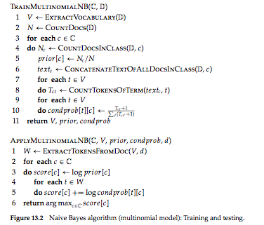
[Manning et al. 2008]

Slide 45
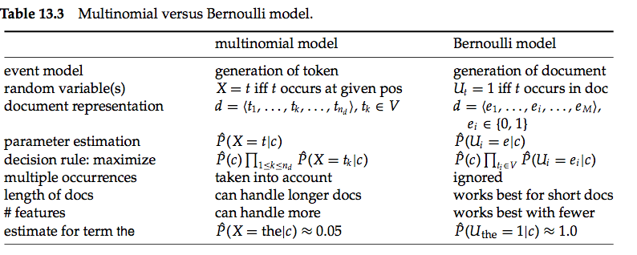
[Manning et al. 2008]

Slide 46
Naive Bayes model
Class assignment:
  find the k most probable classes; k = 1:
  alternative: select classes for which
Advantages:
  Efficiency
Disadvantages:
  Independence assumptions
  No accurate probability estimates: close to 0; winning class after normalization close to 1

Slide 47
Maximum entropy principle
Used in classifiers that compute a probabilistic class assignment
Maximum entropy principle: given a set of training data, model what is known and assume no further knowledge about the unknowns by assigning them equal probability
In other words we choose the model p* that preserves as much uncertainty as possible between all the models p ∈ P that satisfy the constraints enforced by the training examples
Examples:
  maximum entropy model
  conditional random field

Slide 48
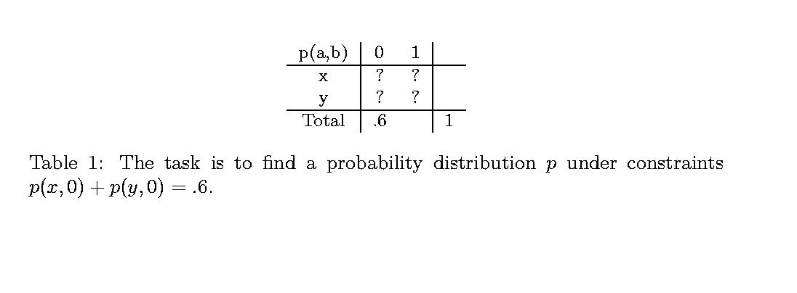
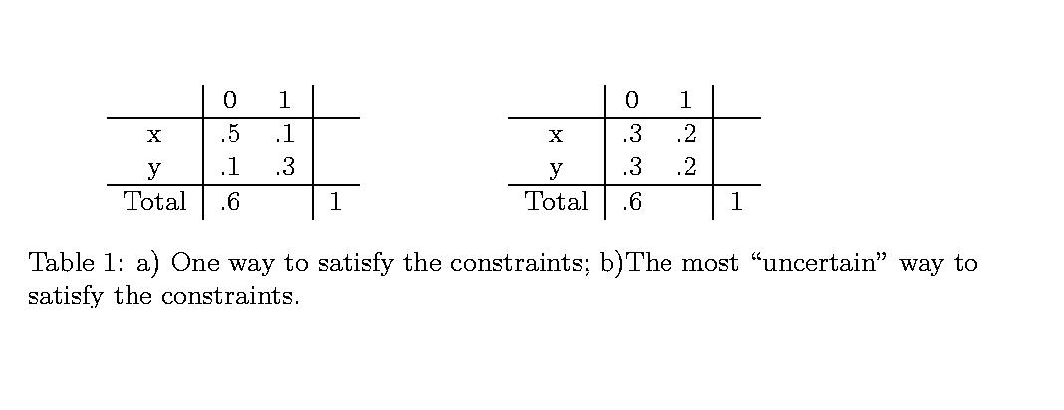

Slide 49
Maximum entropy model
Given n training examples S = {(x, y)₁,…,(x, y)_{n}}.
where x = feature vector and y = class
We choose the model p* that preserves as much uncertainty as possible, or which maximizes the entropy H(p) between all the models p ∈P that satisfy the constraints enforced by the training examples:
  H(p) =

Slide 50
Maximum entropy model
The training data are described with k feature functions*:
e.g.,
* Are usually binary-valued because of efficient training

Slide 51
Maximum entropy model
The statistics of a feature function is captured by ensuring that the model adheres to the following equality:
  where
  (1)
  = expectation of the feature function f_{j}
  (2)
  = empirical expectation of the feature function f_{j}
(approximated)

Slide 52
Maximum entropy model
The principle of maximum entropy recommends that we use p*:
It has been shown that p*(S) is unique and must be in the following form:
(3)
where
f_{j}(x, y) = one of the k binary-valued feature functions
λ_{j} = parameter adjusted to model the observed statistics
Z = normalizing constant

Slide 53
Maximum entropy model: training
The empirical distribution (2) is estimated from the training data via maximum likelihood estimation:
(x₂ = “say”, y = person)
≈ count (x₂ = “say” and y = person)/N where N is the total number of training events
The model must adjust the parameter λ_{j} such that its expectation of f_{j} matches the empirical one, while simultaneously matching the rest of the feature functions with their expectations
The model estimates p*(S) by adjusting the k model parameters λ_{j ,} 1 < = j <= k, subject to the constraints of the k feature functions
e.g., by the generalized iterative scaling algorithm

Slide 54
Maximum entropy model
Generalized iterative scaling:
input: feature functions: f₁,…, f_{k}, empirical distribution
output: for the feature functions: the optimal parameter values λ_{j}
The algorithm requires that the sum of the features for each possible (x,y) is equal to a constant C, which is set at the greatest possible feature sum and therefore adds a feature as:
Initialize {λ_{j}⁽¹⁾}, usually we choose λ_{j}⁽¹⁾ = 1 , 1 <= j <= k +1

Slide 55
Maximum entropy model
Iteration:
1. Compute p^{(l)}(x,y) for the distribution p^{(l)} given by the {λ_{j}^{(l)}}, for each element (x,y) in the training set with (3) taking into account k+1 features
2. Compute according to (1) 1<=j<=k+1
3. Update the parameters λ_{j} :
Iteration stops: when the differences between λ_{j}^{(l)} and λ_{j}^{(l+1)} are very small

Slide 56
Maximum entropy model
To classify new information unit with feature vector x: compute (3) for each possible class y and choose y with greatest probability
Advantages:
  good results:
    when dependencies exist between the features
    with incomplete training data
  no need for a priori feature selection

Slide 57
Maximum entropy model
For example, used in named entity recognition:
  = assignment of a semantic class to a named entity in the text
  often restricted to the classification of proper names: i.e., as persons, companies, locations, currencies, ...
  maximum entropy classification gives good results even with a limited number of training examples, e.g., MENERGI-system in next example

Slide 58
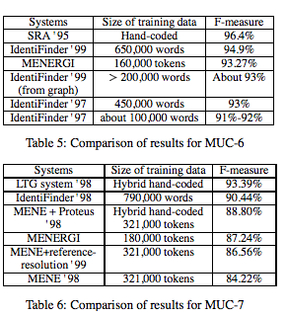
[Chieu & Ng COLING. 2002]

Slide 59
For example, used in temporal relation recognition:
  Problem of data sparseness: here use of temporal reasoning to artificially expand the amount of training data (“CLOSED” in next slide): e.g.,
    If relation (A,B) = BEFORE && relation (B,C) = INCLUDES
      then infer relation (A,C) = BEFORE

Slide 60
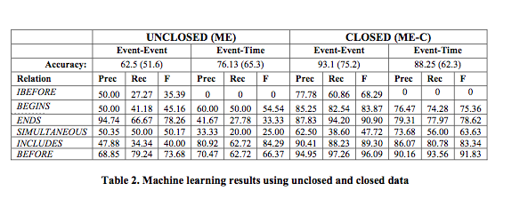
[Mani et al. COLING-ACL 2006]

Slide 61
References
Bakir G.H., Hofmann, T.,Schölkopf, B., Smola, A.J., Taskar, B. & Vishwanathan, S.V.N. (2007) (Eds.), Predicting Structured Data. Cambridge, MA: MIT Press.
Berger, Adam, Stephen A. Della Pietra and Vincent J. Della Pietra (1996). A maximum entropy approach to natural language processing. Computational Linguistics, 22 (1), 39-71.
Chieu, H.L. & Ng Hwee Tou (2002). Named entity recognition: a maximum entropy approach using global information. In COLING 2002. Proceedings of the 19th International conference on Computational Linguistics (pp. 190-196). San Francisco: Morgan Kaufmann.
Collins, M. & Duffy, N. (2002). Convolution kernels for natural language. In T.G. Dieterich, S. Becker & Z. Ghahramani (Eds.), Advances in Neural Information Processing Systems 14 (pp. 625-632. Cambridge, MA: The MIT Press.
Culotto, Aron and Jeffrey Sorenson (2004). Dependency tree kernels for relation extraction. In Proceedings of the 42nd Annual Meeting of the Association for Computational Linguistics (pp. 424-430). East Stroudsburg, PA: ACL.
Krishnan, V. & C.D. Manning (2006). An effective two-stage model for exploiting non-local dependencies in named entity recognition. Proceedings of COLING-ACL 2006 (pp. 1121-1128). East Stroudsburg, PA: ACL.

Slide 62
References
Mani, I. et al. (2006). Machine learning of temporal relations. In Proceedings of COLING-ACL 2006 (pp. 753-760). East Stroudsburg, PA: ACL.
Manning, C.D., Raghaven, P. & Schüze, H. (2008). Introduction to Information Retrieval. Cambridge University Press.
Moens, M.-F. (2006). Information Extraction: Algorithms and Prospects in a Retrieval Context (The Information Retrieval Series 21). New York: Springer.
Riloff, E. (1996). An empirical study for automated dictionary construction for information extraction in three domains. Artificial Intelligence 85, 101-134.
Soderland, S. (1999). Learning information extraction rules for semi-structured and free text. Machine Learning: http://citeseer.nj.nec.com/soderland99learning.html
Sutton, C. & McCallum A. (2007). Introduction to statistical relational learning. In L. Getoor & B. Taskar (Eds.), Introduction to Statistical Relational Leaning (pp. 93-127). Cambridge, MA: The MIT Press.
Vishwanathan, S.V.N. & Smola, A.J. (2004). Fast kernels for string and tree matching. In K. Tsuda, B. Schölkopf and J.P. Vert (Eds.), Kernels and Bioinformatics. Cambridge, MA, The MIT Press.

